Slide 1

Form Validation

Slide 2
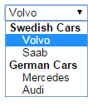
HTML Forms
The <form> tag is used to create an HTML form for user input.
The <form> element can contain one or more of the following form elements:
<input>
<textarea>
<button>
<select>
<option>
<optgroup>
<fieldset>
<label>
<input type="text">
<input type="submit">
<input type="radio“>
Example of <optgroup>:

Slide 3
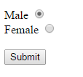
HTML Forms
Example of <label>
<form> <label for="male">Male</label> <input type="radio" name="sex" id="male" value="male">
<br> <label for="female">Female</label> <input type="radio" name="sex" id="female" value="female">
<br> <input type="submit" value="Submit"> </form>
The for attribute of the <label> tag should be equal to the id attribute of the related element to bind them together.

Slide 4
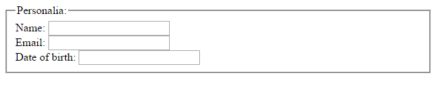
HTML Forms
Example of <fieldset>
<form> <fieldset> <legend>Personalia:</legend> Name: <input type="text"><br> Email: <input type="text"><br> Date of birth: <input type="text"> </fieldset> </form>
Notes:
Fieldset and Legend are used to group related elements in a form

Slide 5
Accessing Forms
<form id=“myForm" action="demo_form.asp" method="post">
First name: <input type="text" name="fname"><br>
Last name: <input type="text" name="lname"><br>
<input type="submit" value="Submit">
</form>
Every time you add a set of <form> and </form> tags to an HTML document, a form object is created.
To access one of the forms using JavaScript, you can use any one of the following options:
Use the forms array of the document object. For example document.forms[0] allows you to reference the first form in the document.
document.forms["myForm"]["fname"].value (form id, form field)
Give the form an id in the opening form tag and access it using the document.getElementById() method.

Slide 6
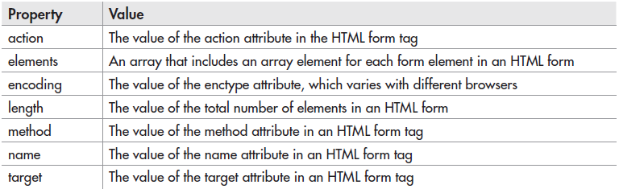
Form Properties
The form object’s properties provide information you might need when working with forms in your scripts.
action: URL. Specifies where to send the form data when a form is submitted
method: get/post. Specifies the HTTP method to use when sending form data
target:_blank/_self/_parent/_top. Specifies where to display the response that is received after submitting the form

Slide 7
Form Input Attributes
The <input> tag specifies an input field where the user can enter data.
The <input> element is empty, it contains attributes only.
In HTML, the <input> tag has no end tag.
List of <input> attributes:
http://www.w3schools.com/tags/tag_input.asp
Some <input> types:
text
password
checkbox radio
reset submit
http://www.w3schools.com/tags/att_input_type.asp
Note:
Not all browsers support all HTML5 input types and CSS selectors.
Notes:
Checked, disabled, alt, height, min, name, id, readonly, placeholder

Slide 8
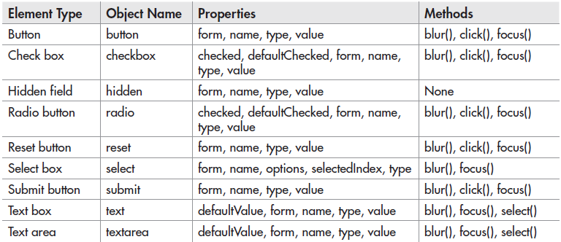
Form Elements
Each form element is an instance of an object with its own properties and methods. Most of them are common across elements.
Hidden: does not show on the page, used to submit information not entered by the user

Slide 9
Element Properties
checked property is used with check boxes and radio buttons. It has a Boolean value, which is true if the box or button is checked and false if it isn’t.
defaultChecked property value depends on whether the check box or radio button has the checked attribute in its HTML.
If the element has the checked attribute, the value is true.
If not, the value is false.
Checkbox: <input type="checkbox" id="myCheck" checked>
var x = document.getElementById("myCheck").defaultChecked;
// returns “true”

Slide 10
Element Properties
defaultValue is used with text boxes and text areas. It holds the value of the default value set in the value attribute of the element’s tag. This capability can be useful if you set a default value in a text box, the user deletes it, and then the user decides it would be nice to have the default value back:
<body>
<form>
URL:<br>
<input type="text" id="favurl" value="http://www.google.com">
<br><br>
<input type="button" value="Reset Default" onclick="back_to_default();">
</form>
<script>
function back_to_default() {
var url_box = document.getElementById("favurl");
url_box.value = url_box.defaultValue;
}
</script>
</body>
Notes:
Ex1

Slide 11
Element Properties
form property is often used with the keyword “this” to refer to the form that contains the element that uses it. For instance, if you want to change the value of a text box by clicking a button, you could refer to the form by using this.form rather than needing the name or id of the form:
<form>
URL:<br>
<input type="text" name="favurl" value="http://www.google.com">
<br><br>
<input type="button" value="Change"
onclick="this.form.favurl.value='http://www.reddit.com';">
</form>
Result
This code changes the current value of the text box when the button is clicked. Using this.form.favurl.value allows you to access the same form from an element within it without having to go back and use a form name or id, which is a bit longer.

Slide 12
Element Properties
options property is an array that contains an element for each option listed in a select box in a form. For example this is how you can access the value of an option and write it on the page:
<body>
<form>
Fruits:
<select id="optlist">
<option selected="selected" value="orange">Orange</option>
<option value="apple">Apple</option>
<option value="pear">Pear</option>
</select>
</form>
<script>
var fbox = document.getElementById("optlist");
document.write("The second option is " + fbox.options[1].value);
</script>
</body>
Notes:
Ex2

Slide 13
Element Properties
name property holds the value of the name attribute of an element. Each input field must have a name attribute to be submitted. If not, the data of that input field will not be sent at all.
selectedIndex property holds the value of the index number of the option that the viewer has selected. If the first option is selected, the value is 0. If the second option is selected, the value is 1.
type property holds the value of the type property for a form input element, such as type=“text” or type=“button”.
value property holds the current value of an element. For instance, a text box may have no default value; but when the viewer inputs information into the box, the text box has a current value. If nothing is in the box, the current value would be an empty string. You will use this property frequently for information, validation, and navigation with forms.

Slide 14
Element Methods
blur() method allows you to create a blur event on an element in your code.
For example, if you want to keep your default value in a text box from being adjusted by the viewer, you could use the blur() method to remove focus from an element if it receives focus from the viewer. Clicking the text box gives it focus, but the onfocus event handler catches the focus on the text box and then uses the blur() method on the element to remove focus from it.
<body>
<form>
Your Favourite Food
<input type="text" name="fav_food" value="Pizza" onfocus="this.blur();"><br>
Your Favourite Plant
<input type="text" name="fav_plant" value="Orchid">
</form>
</body>
Notes:
Ex3

Slide 15
Element Methods
click() method allows you to create a click event on a button in your code. However, a click created this way doesn’t activate the onclick event handler if it is used in the button. Thus, the click() method is most useful for activating buttons such as submit and reset buttons, which don’t need an onclick event handler to work.
For instance, a reset button will reset a form when clicked. If you want to reset a form when a field loses focus (and really irritate the viewer), you could use the following code:
<body>
<form>
Your Favorite Food
<input type="text" name="fav_food">
<br>
Your Favourite Plant
<input type="text" name="fav_plant" onblur="this.form.annoy.click();">
<br><br>
<input type="reset" name="annoy" value="Reset Form">
</form>
</body>
Notes:
Ex4

Slide 16
Element Methods
focus() method lets you create a focus event in your code so that you can bring a certain form element into focus for the viewer.
For example, you might want to give focus to the first form element on a page (usually a text box) as soon as the page loads so that the viewer doesn’t have to click the element to bring it into focus and begin typing:
<body>
<form>
Your Favorite Food
<input type="text" name="fav_food“ id="fav_food"><br>
Your Favourite Plant
<input type="text" name="fav_plant">
</form>
<script>
var f_box = document.getElementById("fav_food");
f_box.focus();
</script>
</body>
Notes:
Ex5

Slide 17
Element Methods
select() method allows you to automatically select (highlight) the contents of a text box or a text area for the viewer. This is useful if you have set a default value for the element and would like the viewer to be able to quickly delete the value to type a new one, or if you want to make it easy for the viewer to copy and paste the contents of the element.
The following code selects the text in a text area when the viewer gives it focus, making it possible for the viewer to quickly delete the text or to easily copy it to the clipboard:
<body>
<form>
<textarea onfocus="this.select();">
This text is the default text for the text area and is selected when the text area is given focus by the viewer.
</textarea>
</form>
</body>
Notes:
Ex6

Slide 18
Form Methods: reset()
reset() method enables you to reset a form using your script, allowing you to reset the form on any event you like. So, if you want to reset a form after the viewer removes focus from an element, you could use the following:
<body>
<form>
Your Favorite Food
<input type="text" name="fav_food" onblur="this.form.reset();">
<br>
Your Favourite Plant
<input type="text" name="fav_plant">
<br><br>
<input type="reset" value="Reset Form">
<input type="submit" value="Submit Form">
</form>
</body>

Slide 19
Form Methods: submit()
submit() method allows you to submit a form without the viewer clicking the submit button. The following code shows how to do this when the viewer removes focus from an element (much the same way as with the reset() method):
<body>
<form action="https://site.com/php/form.php">
Your Favorite Food
<input type="text" name="fav_food" onblur="this.form.submit();">
<br>
Your Favourite Plant
<input type="text" name="fav_plant">
<br><br>
<input type="submit" value="Submit Form">
</form>
</body>
Notes:
Ex8

Slide 20
Not Assuming Client-Side Scripting
When coding a form, it’s best not to assume that JavaScript will be available.
The best practice is to allow the form to be sent to the server side even if JavaScript is unavailable.
<form method="post" action="form.php" onsubmit="return check_form();">
<!-- form contents here -->
<input type="submit" name="submit" id="submit" value="Submit Form" />
</form>
This allows you to run check_form() if JavaScript is available.
Otherwise, the onsubmit event handler will be ignored and the form will be submitted to the server-side script for validation and handling.
If JavaScript is available, the validation routine can save a trip to the server and provide the user with real-time helpful messages.
However, you should always validate your form data at the server anyway, for security reasons.

Slide 21
JavaScript Validation
The idea behind JavaScript form validation is to provide a method to check the information entered by users before they can even submit it.
JavaScript also lets you display helpful alerts to inform the user as to what information was entered incorrectly and how they can fix it.
Some of the things you can check for:
If a text input is empty or not.
If a text input is all numbers, letters, or alphanumeric (numbers & letters).
If a text input has the correct number of characters in it (useful when restricting the length of a username and/or password).
If a selection has been made from an HTML select input (the drop down selector).
If an email address is valid.
etc.

Slide 22
Checking for Non-Empty
If a form field (fname) is empty, the required attribute prevents this form from being submitted:
<form action="demo_form.asp" method="post">
<input type="text" name="fname" required>
<input type="submit" value="Submit">
</form>
If you click submit, without filling out the text field, your browser will display an error message.
Note:
Error message bubbles use generic text (e.g., ‘please fill out this field’) and are not easy to style.
Automatic HTML form validation does not work in Internet Explorer 9 or earlier. Therefore, you’ll have to check the length of the field, e.g.,
if(fname.value.length == 0) return false;
Notes:
Ex9

Slide 23
Restricting the Length
<form>
Username(6-8 characters): <input type='text' id='restrict'>
<input type='button'
onclick="lengthRestriction(document.getElementById('restrict'), 6, 8)"
value='Check Field'>
</form>
<script>
function lengthRestriction(elem, min, max){
var uInput = elem.value;
if(uInput.length >= min && uInput.length <= max){
return true;
}else{
alert("Please enter between " +min+ " and " +max+ " characters");
elem.focus();
return false;
}
}
</script>
Notes:
Ex10

Slide 24
Checking for Numbers
https://www.w3schools.com/jsref/jsref_obj_global.asp
JavaScript isNaN() function
isNaN(123) ; false isNaN(-1.23) ; false isNaN(5-2) ; false isNaN(0); false isNaN("Hello") ; true isNaN("2005/12/12") ; true
isNaN("undefined") ; true
Remember that the values returned from text fields will be strings. If you need, parseInt() will convert these strings to numbers.
Notes:
The isNaN() function determines whether a value is an illegal number (Not-a-Number).

Slide 25
Regular Expressions
Regular expression allow you to check for patterns in strings.
/^[0-9]+$/ OR
/^\d+$/
at least one numeric character long
function isNumeric(elem){
if(elem.value.match(/^[0-9]+$/)){
return true;
} else{
alert('Digits only allowed');
return false;
}
}
The RegEx starts and ends with /
^ is the beginning
+ is one or more times the previous
$ is the end
Notes:
Ex11

Slide 26
Regular Expressions
/^[a-zA-Z]+$/
both lowercase and uppercase letters
/^[0-9a-zA-Z]+$/
numbers and letters
Regular Expressions:
https://developer.mozilla.org/en/docs/Web/JavaScript/Guide/Regular_Expressions
Test Regular Expressions:
https://regex101.com/ OR https://regexr.com/

Slide 27
Email Validation
Every email is made up for 5 parts:
A combination of letters, numbers, periods, hyphens, plus signs, and/or underscores
The at symbol @
A combination of letters, numbers, hyphens, and/or periods
A period
The top level domain (com, net, org, us, gov, ...) with 2 to 4 letters or numbers
Valid Examples:
bobby.jo@filltank.net
jack+jill@hill.com
the-stand@steven.king.com
Invalid Examples:
@deleted.net - no characters before the @
free!dom@bravehe.art - invalid character !
shoes@need_shining.com - underscores are not allowed in the domain name

Slide 28
Email Validation
/^[\w\-\.\+]+\@[a-zA-Z0-9\.\-]+\.[a-zA-z0-9]{2,4}$/
\w Matches any alphanumeric character including the underscore. Equivalent to [A-Za-z0-9_]
\ A backslash that precedes a special character indicates that the next character is not special and should be interpreted literally.
{n, m} n and m are positive integers and n <= m. Matches at least n and at most m occurrences of the preceding character. If m is omitted, = ∞
Notes:
<input type="email" placeholder="foo@this.com”>

Slide 29
Selection Made
To be sure that someone has actually selected a choice from an HTML select input, you can use a simple trick of making the first option as helpful prompt to the user and a red flag to you for your validation code.
By making the first option of your select input something like "Please Choose", you can spur the user to both make a selection and allow you to check to see if the default option "Please Choose" is still selected when the submit the form.

Slide 30
Selection Made
<form>
Selection: <select id='selection'>
<option>Please Choose</option>
<option>CA</option>
<option>WI</option>
<option>XX</option>
</select>
<input type='button'
onclick="madeSelection(document.getElementById('selection'), 'Please Choose Something')"
value='Check Field'>
</form>
<script>
function madeSelection(elem, helperMsg){
if(elem.value === "Please Choose"){
alert(helperMsg);
elem.focus();
return false;
} else{
return true;
}
}
</script>
Notes:
Ex12

Slide 31
Intro to JavaScript Validation API
HTML5 introduced new mechanisms for forms:
New semantic types for the <input> element.
Constraint validation to make it easier to check form content on the client side.
Basically, the usual constraints can be checked without the need for JavaScript by:
Choosing the most appropriate input type.
<input type="URL">
<input type="email">
Setting new attributes
More complex constraints can be tested using the Constraint Validation API.
Note:
HTML5 Constraint validation doesn't remove the need for server side validation.
https://developer.mozilla.org/en-US/docs/Web/Guide/HTML/HTML5/Constraint_validation
http://www.w3schools.com/js/js_validation_api.asp
Notes:
Ex13

Slide 32
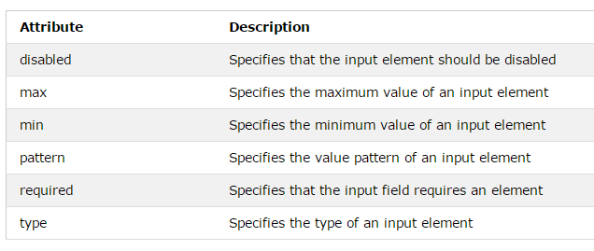
Constraint Validation HTML Input Attributes
pattern="[A-Za-z]{3}" // 3 letters

Slide 33
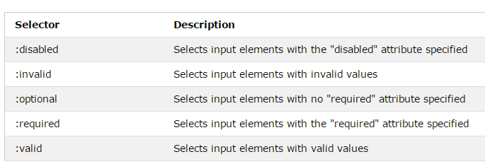
Constraint Validation CSS Pseudo Selectors
selector:pseudo-class {
property:value;
}
input:invalid | Selects all <input> elements with an invalid value

Slide 34
Constraint Validation Process
Constraint validation is done through the Constraint Validation API either on:
A single form element, or
At the form level, on the <form> element itself.
Performed as follows:
By a call to the checkValidity() method of a form element. In this instance, checkValidity() evaluates the constraints only on the element.
By a call to the checkValidity() function on the form.
By submitting the form itself.
Notes:
Ex13

Slide 35
checkValidity()
<!DOCTYPE html>
<html>
<body>
<p>Enter a number and click OK:</p>
<input id="id1" type="number" min="100" max="300" required>
<button onclick="myFunction()">OK</button>
<p>If the number is less than 100 or greater than 300, an error message will be displayed.</p>
<p id="demo"></p>
<script>
function myFunction() {
inpObj = document.getElementById("id1");
if (!inpObj.checkValidity()) {
document.getElementById("demo").innerHTML = inpObj.validationMessage;
} else document.getElementById("demo").innerHTML = "Input OK";
}
</script>
</body>
</html>
Notes:
Ex13

Slide 36
JavaScript and the Constraint API
It is possible to implement more complex constraints, e.g.:
Constraints combining several fields, or
Constraints involving complex calculations.
Basically, the idea is to:
Trigger JavaScript on some form field event (e.g., onchange, onclick).
Calculate whether the constraint is violated.
Use the method field.setCustomValidity() to set the result of the validation:
an empty string means the constraint is satisfied, and
any other string means there is an error and this string is the error message to display to the user.
Notes:
Ex13

Slide 37
setCustomValidity()
<body>
<label for="FS">Select a file smaller than 75 kB : </label>
<input type="file" id="FS">
<script>
function checkFileSize() {
var FS = document.getElementById("FS");
var files = FS.files;
// If there is (at least) one file selected
if (files.length > 0) {
if (files[0].size > 75 * 1024) { // Check the constraint
FS.setCustomValidity("The selected file must not be larger than 75 kB");
return;
}
}
// No custom constraint violation
FS.setCustomValidity("");
}
window.onload = function () {
document.getElementById("FS").onchange = checkFileSize;
}
</script>
</body>
Notes:
Ex14

